Slide 1
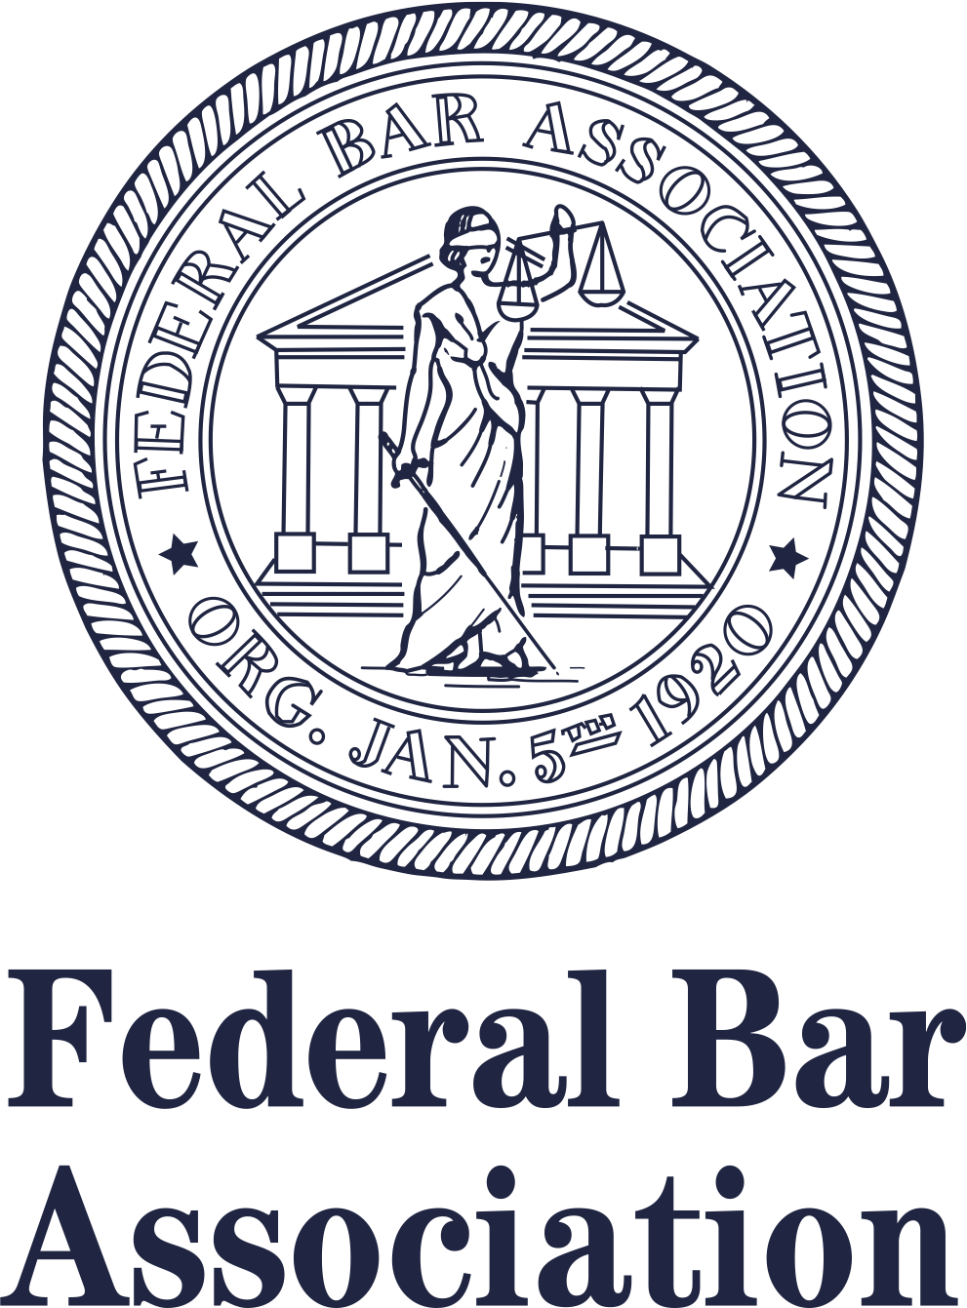
Roanoke Chapter

Slide 2
FBA Mission Statement
The mission of the Association is to strengthen the federal legal system and administration of justice by serving the interests and the needs of the federal practitioner, both public and private, the federal judiciary and the public they serve.

Slide 3
FBA National Membership
19,000+ Members and 2,500+ Law Student Associate Members nationwide
Over 100 Chapters around the country
Retention rate of 83%
Benchmark: Retention rates for similar sized voluntary bar associations ranged from 82-97%

Slide 4
Monthly Membership Counts FY2014-2017

Slide 5

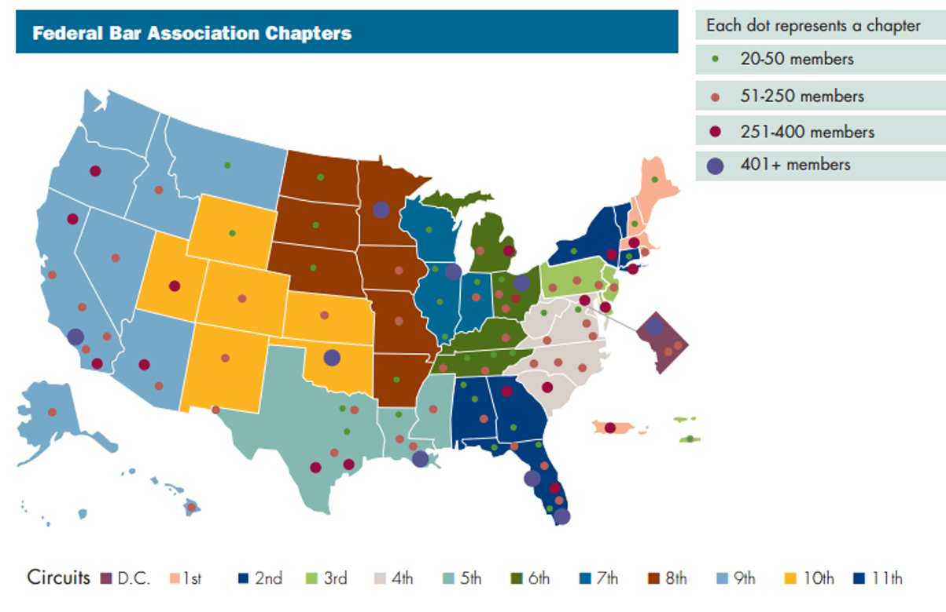
Where are FBA Members?

Slide 6
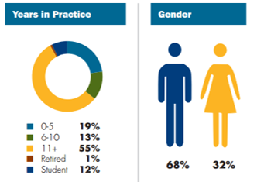
FBA Member Demographics

Slide 7
FBA Sections and Divisions
Sections
Admiralty
Alternative Dispute Resolution
Antitrust & Trade Regulation
Banking
Bankruptcy
Civil Rights
Criminal
Environment, Energy, & Natural Resources
Federal Litigation
Government Contracts
Health
Immigration
Divisions
Corporate & Association Council
Judiciary
Senior Lawyers
Younger Lawyers
Law Student
Indian
Intellectual Property
International
Labor & Employment
LGBT
Qui Tam
Securities
Social Security
State & Local Government Relations
Taxation
Transportation & Transportation Security
Veterans and Military

Slide 8
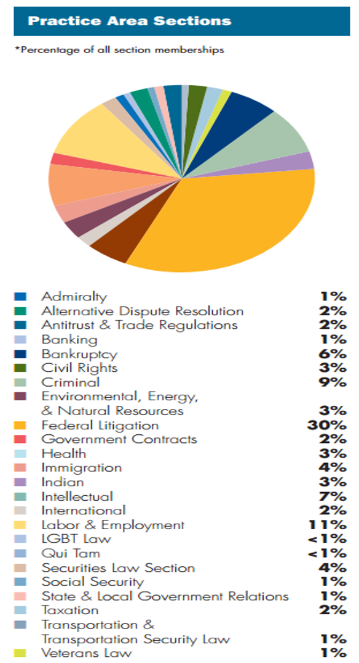
FBA Sections and Divisions

Slide 9
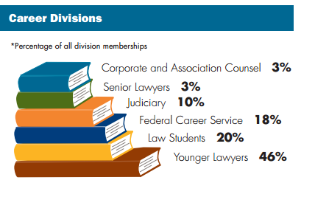
FBA Sections and Divisions

Slide 10
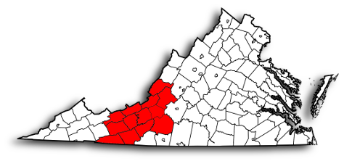
Roanoke Chapter Membership
95 Total Members

Slide 11
Roanoke Chapter Membership
Sections and Divisions within the Roanoke Chapter that have the Most Members

Slide 12

Member Plus Program
FBA members receive discounts from over 25 companies.
Participating organizations include: Avis, Budget, HP, Liberty Mutual, OfficeMax, UBER, UPS, and more.
For a full list of participating partners please visit fedbar.org.

Slide 13

Judicial Profile Index
Contains profiles published in The Federal Lawyer magazine
All profiles from 2007 to present
Organized by circuit and district
Search by keyword
Updated quarterly with both new profiles and historical profiles

Slide 14
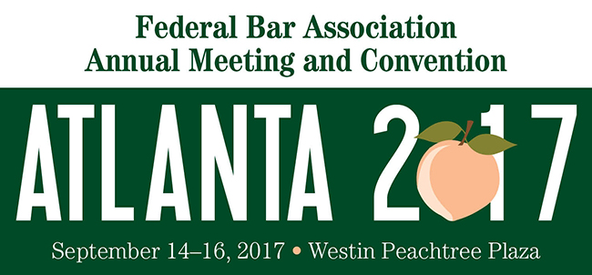
Coming Soon!

