Slide 1
Federal Bar Association
Hon. Raymond L. Acosta Puerto Rico Chapter

Slide 2
The mission of the Association is to strengthen the federal legal system and administration of justice by serving the interests and the needs of the federal practitioner, both public and private, the federal judiciary and the public they serve.
FBA Mission Statement

Slide 3

FBA National Membership
17,000+ Members and nearly 1,400 Law Student Members nationwide
Over 90 Chapters around the country
Retention rate of 82% (excluding law students and honorary members)
Benchmark: Retention rates for similar sized voluntary bar associations ranged from 82-97%

Slide 4
Monthly Membership Counts FY 2013-2015
17,264

Slide 5


Where are FBA Members?

Slide 6


FBA Membership Demographics

Slide 7
FBA Sections and Divisions
Sections
Admiralty
Alternative Dispute Resolution
Antitrust & Trade Regulation
Banking
Bankruptcy
Civil Rights
Criminal
Environment, Energy, & Natural Resources
Federal Litigation
Government Contracts
Health
Immigration
Divisions
Corporate & Association Council
Federal Career Services
Judiciary
Senior Lawyers
Younger Lawyers
Law Student
Indian
Intellectual Property
International
Labor & Employment
Qui Tam
Securities Law
Social Security
State & Local Government Relations
Taxation
Transportation & Transportation Security Law
Veterans Law

Slide 8

FBA Sections and Divisions

Slide 9
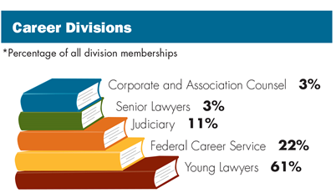
FBA Sections and Divisions

Slide 10

FBA Social Media

Slide 11

Puerto Rico Chapter Membership
490 Total Members

Slide 12
Puerto Rico Chapter Membership
Sections and Divisions within the PR Chapter that have the Most Members

Slide 13
2014 FBA Award Recipient
2014 Chapter Activity Presidential Excellence Award
2014 Outstanding Newsletter Award

Slide 14
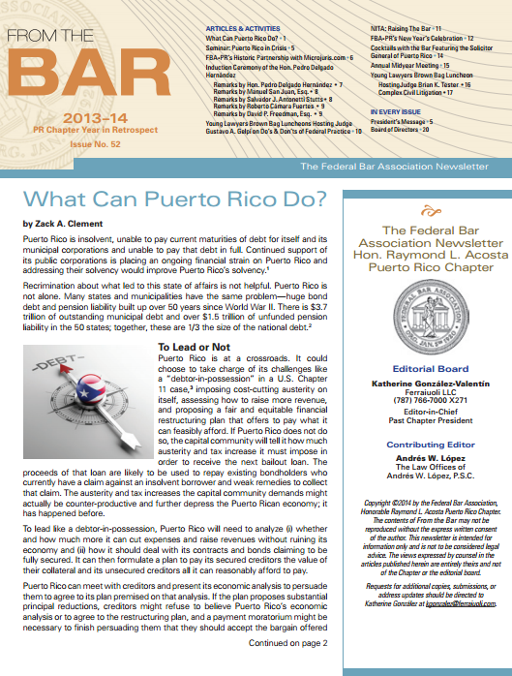
Puerto Rico Chapter Newsletter
WINNER
2014 Outstanding Newsletter Award

Slide 15

What’s New? – Member Plus Program
FBA members receive discounts from over 25 companies.
Participating organizations include: Avis, Budget, HP, Liberty Mutual, OfficeMax, UBER, UPS, and more.
For a full list of participating partners please visit fedbar.org.

Slide 16

What’s New? - Judicial Profile Index
Contains profiles published in The Federal Lawyer magazine
All profiles from 2007 to present
Organized by circuit and district
Search by keyword
Updated quarterly with both new profiles and historical profiles
Federal Bar Association

Slide 17

What Next ? – Coming Soon!
Federal Bar Association

Slide 18
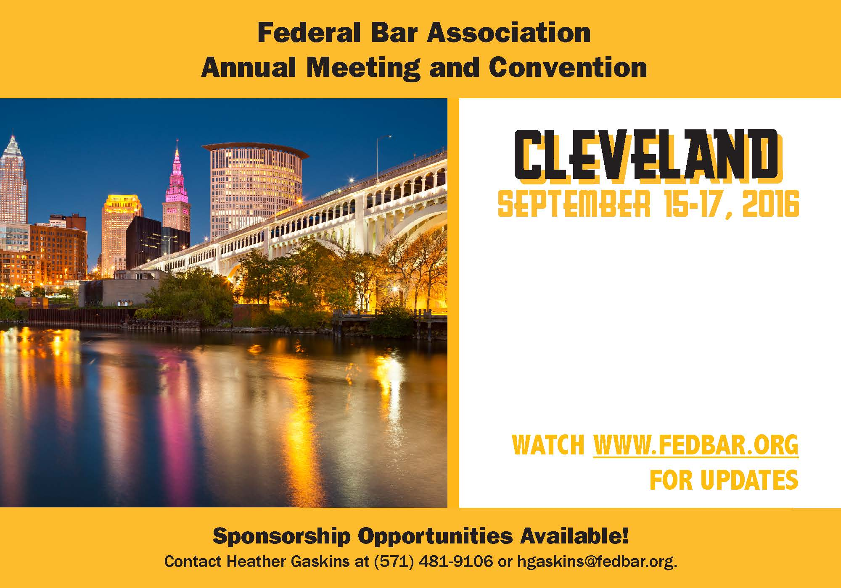
What Next ? – Coming Soon!

