Slide 1
The EDNY JUSTICE INSTITUTE
Honorable Joseph F. Bianco, Eastern District of New York Chapter Civic Education Liaison
Dina Miller, Eastern District of New York Chapter President

Slide 2
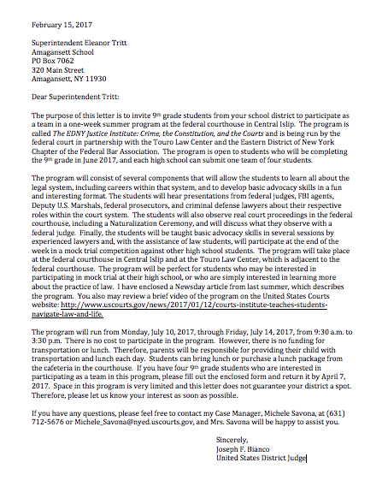
Spread the Word

Slide 3
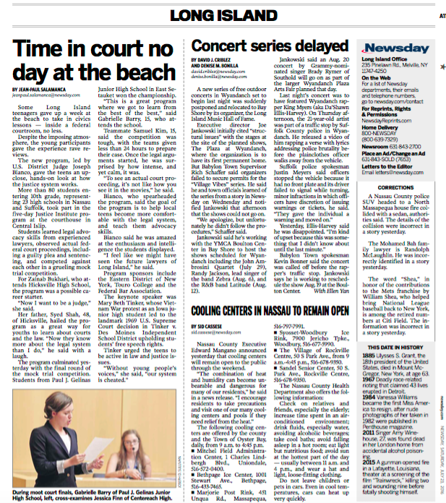

Slide 4
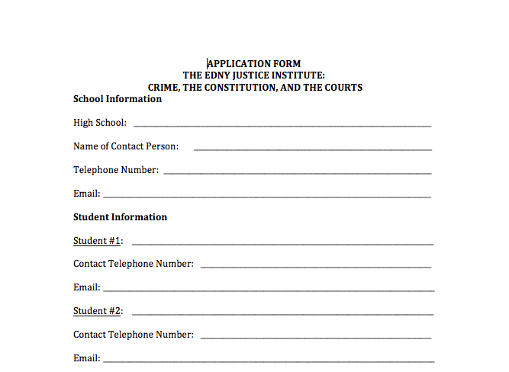
Gather Information

Slide 5
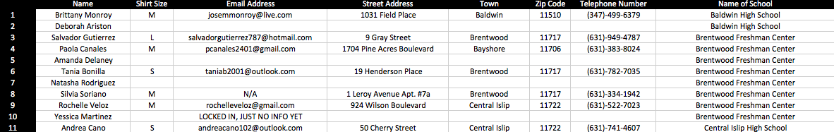
Keep it Organized
Email Address
Name
Street Address
Telephone Number
Emergency Contact
High School
Advisor
Shirt Size
Photo Objection

Slide 6
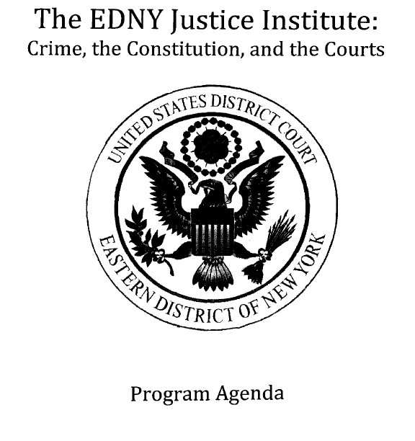
Plan Your Day

Slide 7
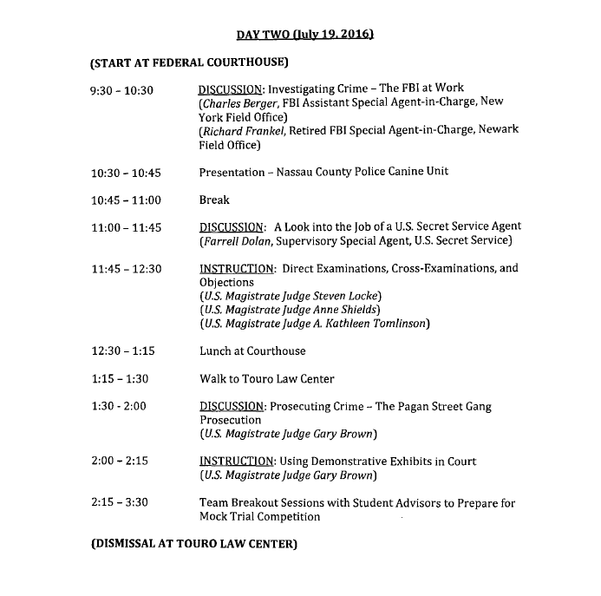

Slide 8
Tips for Planning Your Agenda:
Choose Your Subject Matter
Select Your Speakers
Prepare Your Competition Fact Pattern
Reinforce Your Themes
Keep it Simple

Slide 9
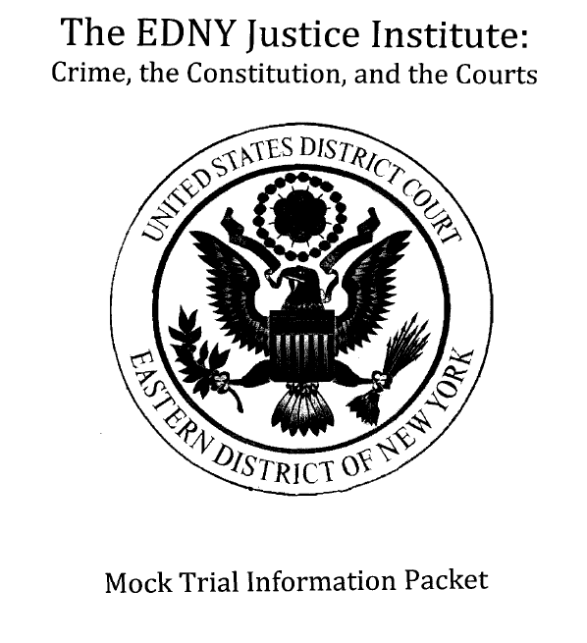

Slide 10
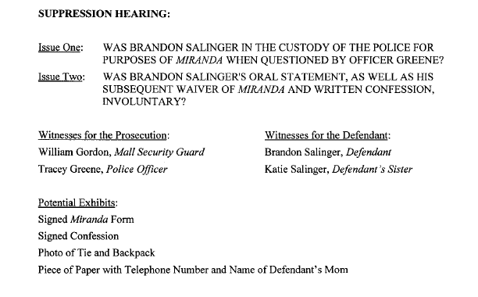

Slide 11
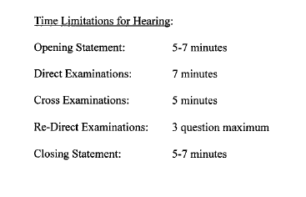

Slide 12
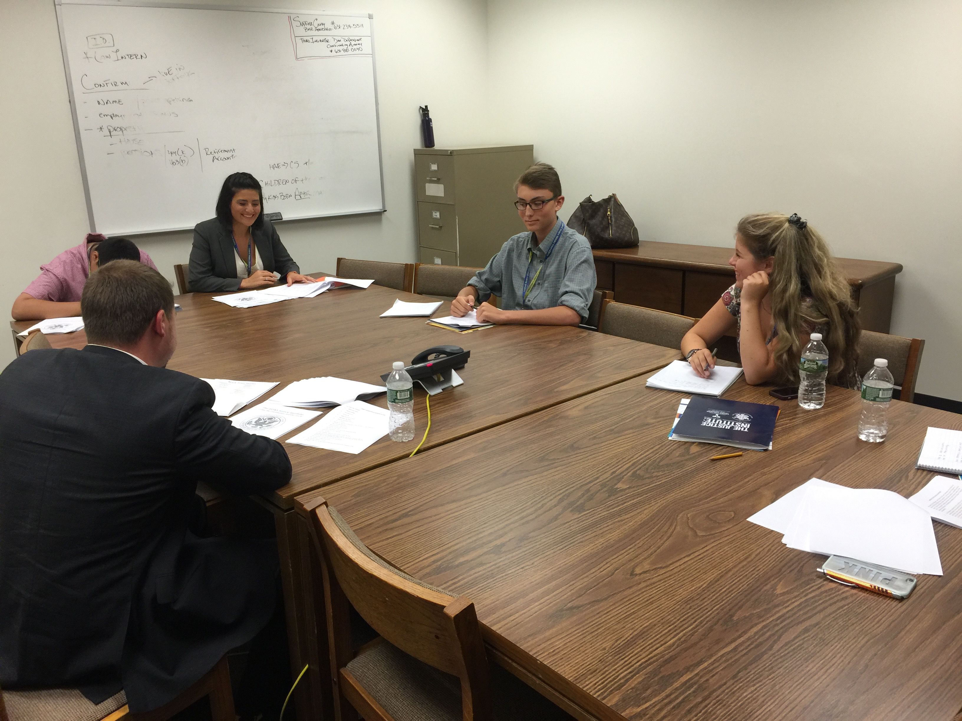
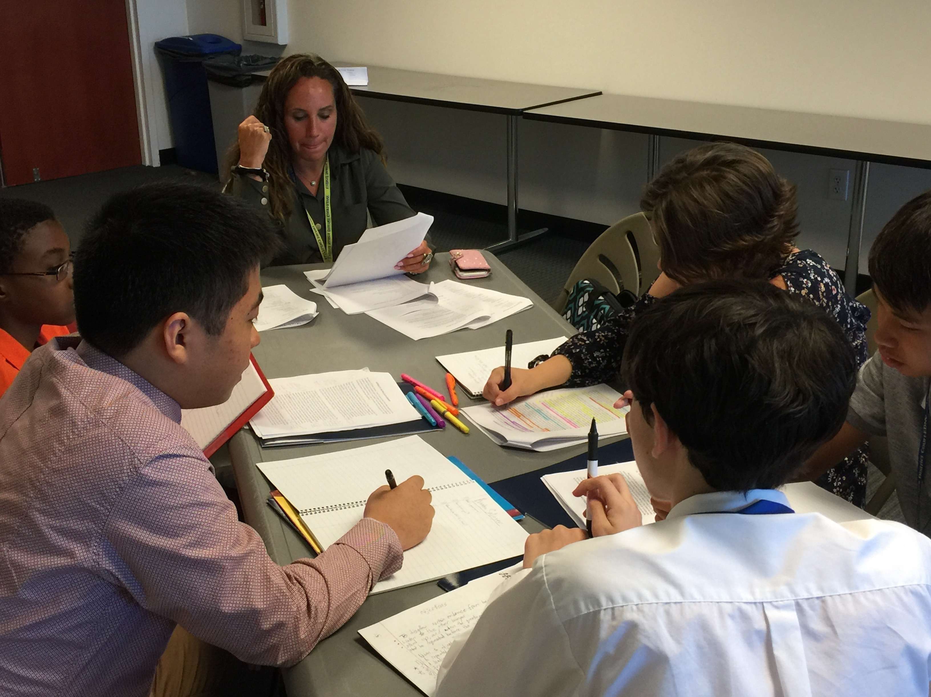
The Benefits of Mentors

Slide 13
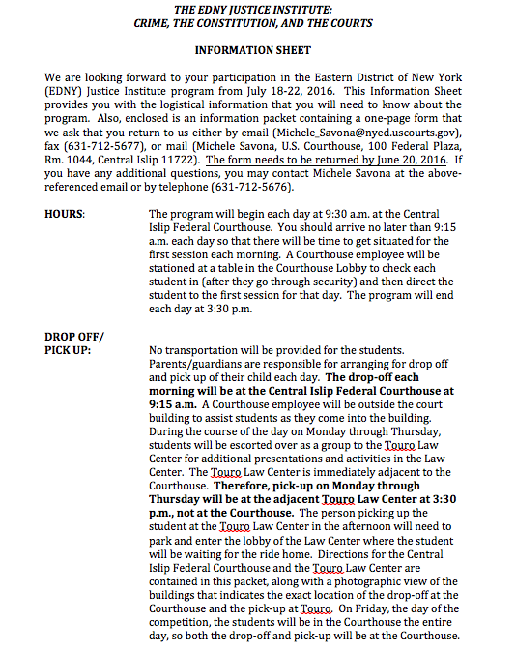
Information for Parents

Slide 14
Key Pieces of Information to Disseminate:
Hours
Drop Off/Pick Up
Directions
Attire
Lunch
Phones
Competition Information

Slide 15
Key Pieces of Information to Gather:
Emergency Contact Information
Photo Objection/Release Form
Lunch Orders
Shirt Sizes
RSVPs to Awards Ceremony/Lunch

Slide 16
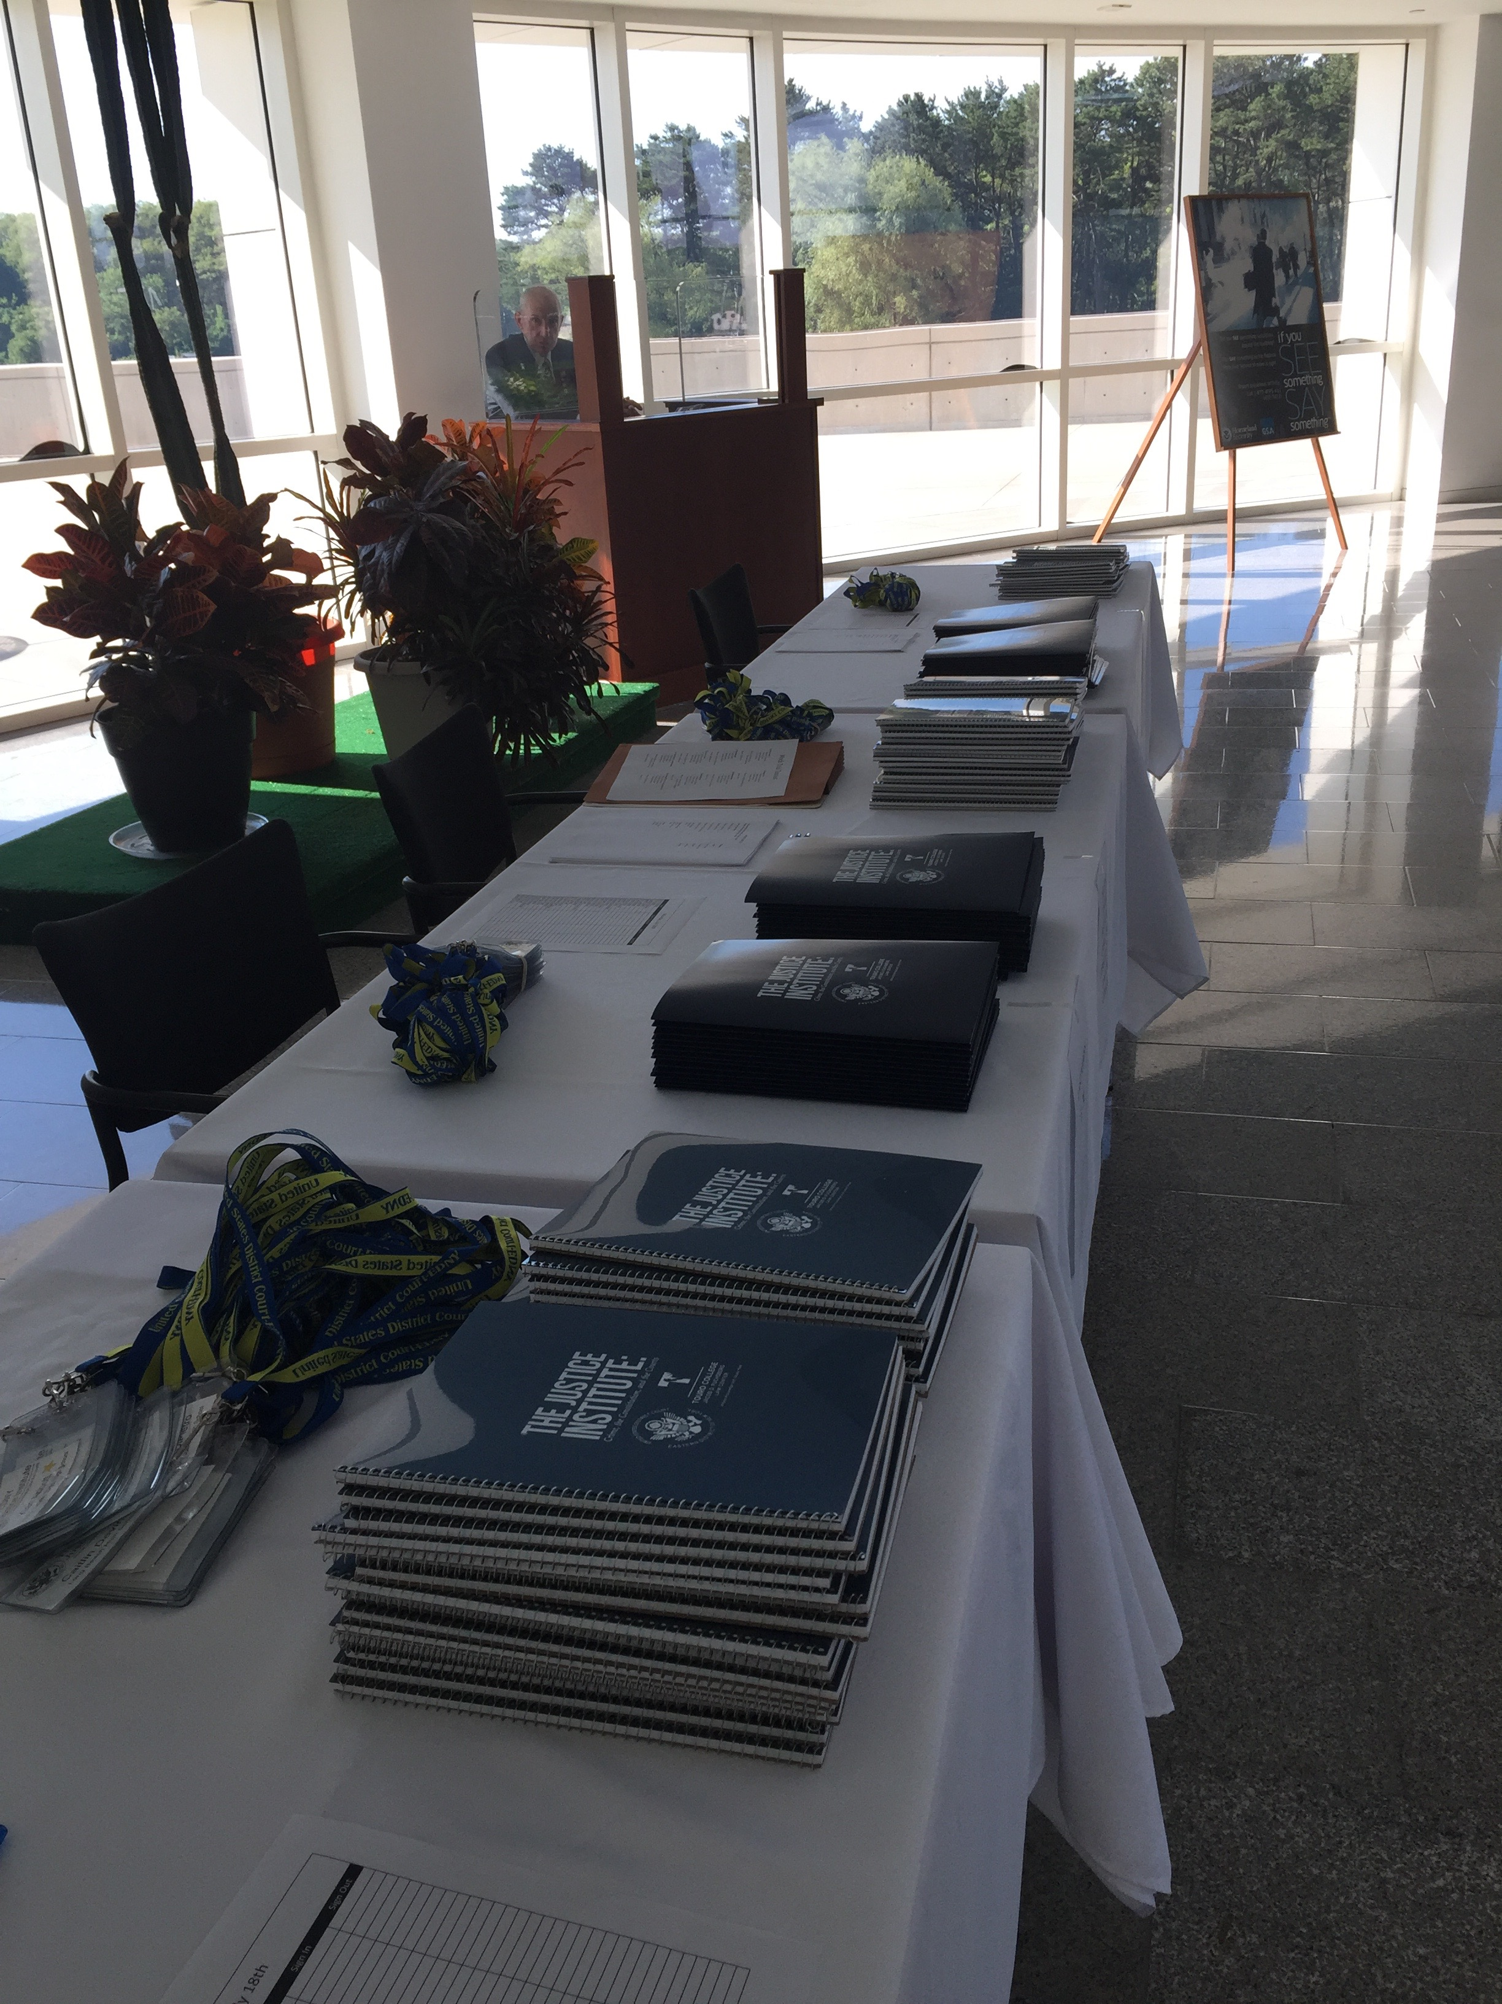
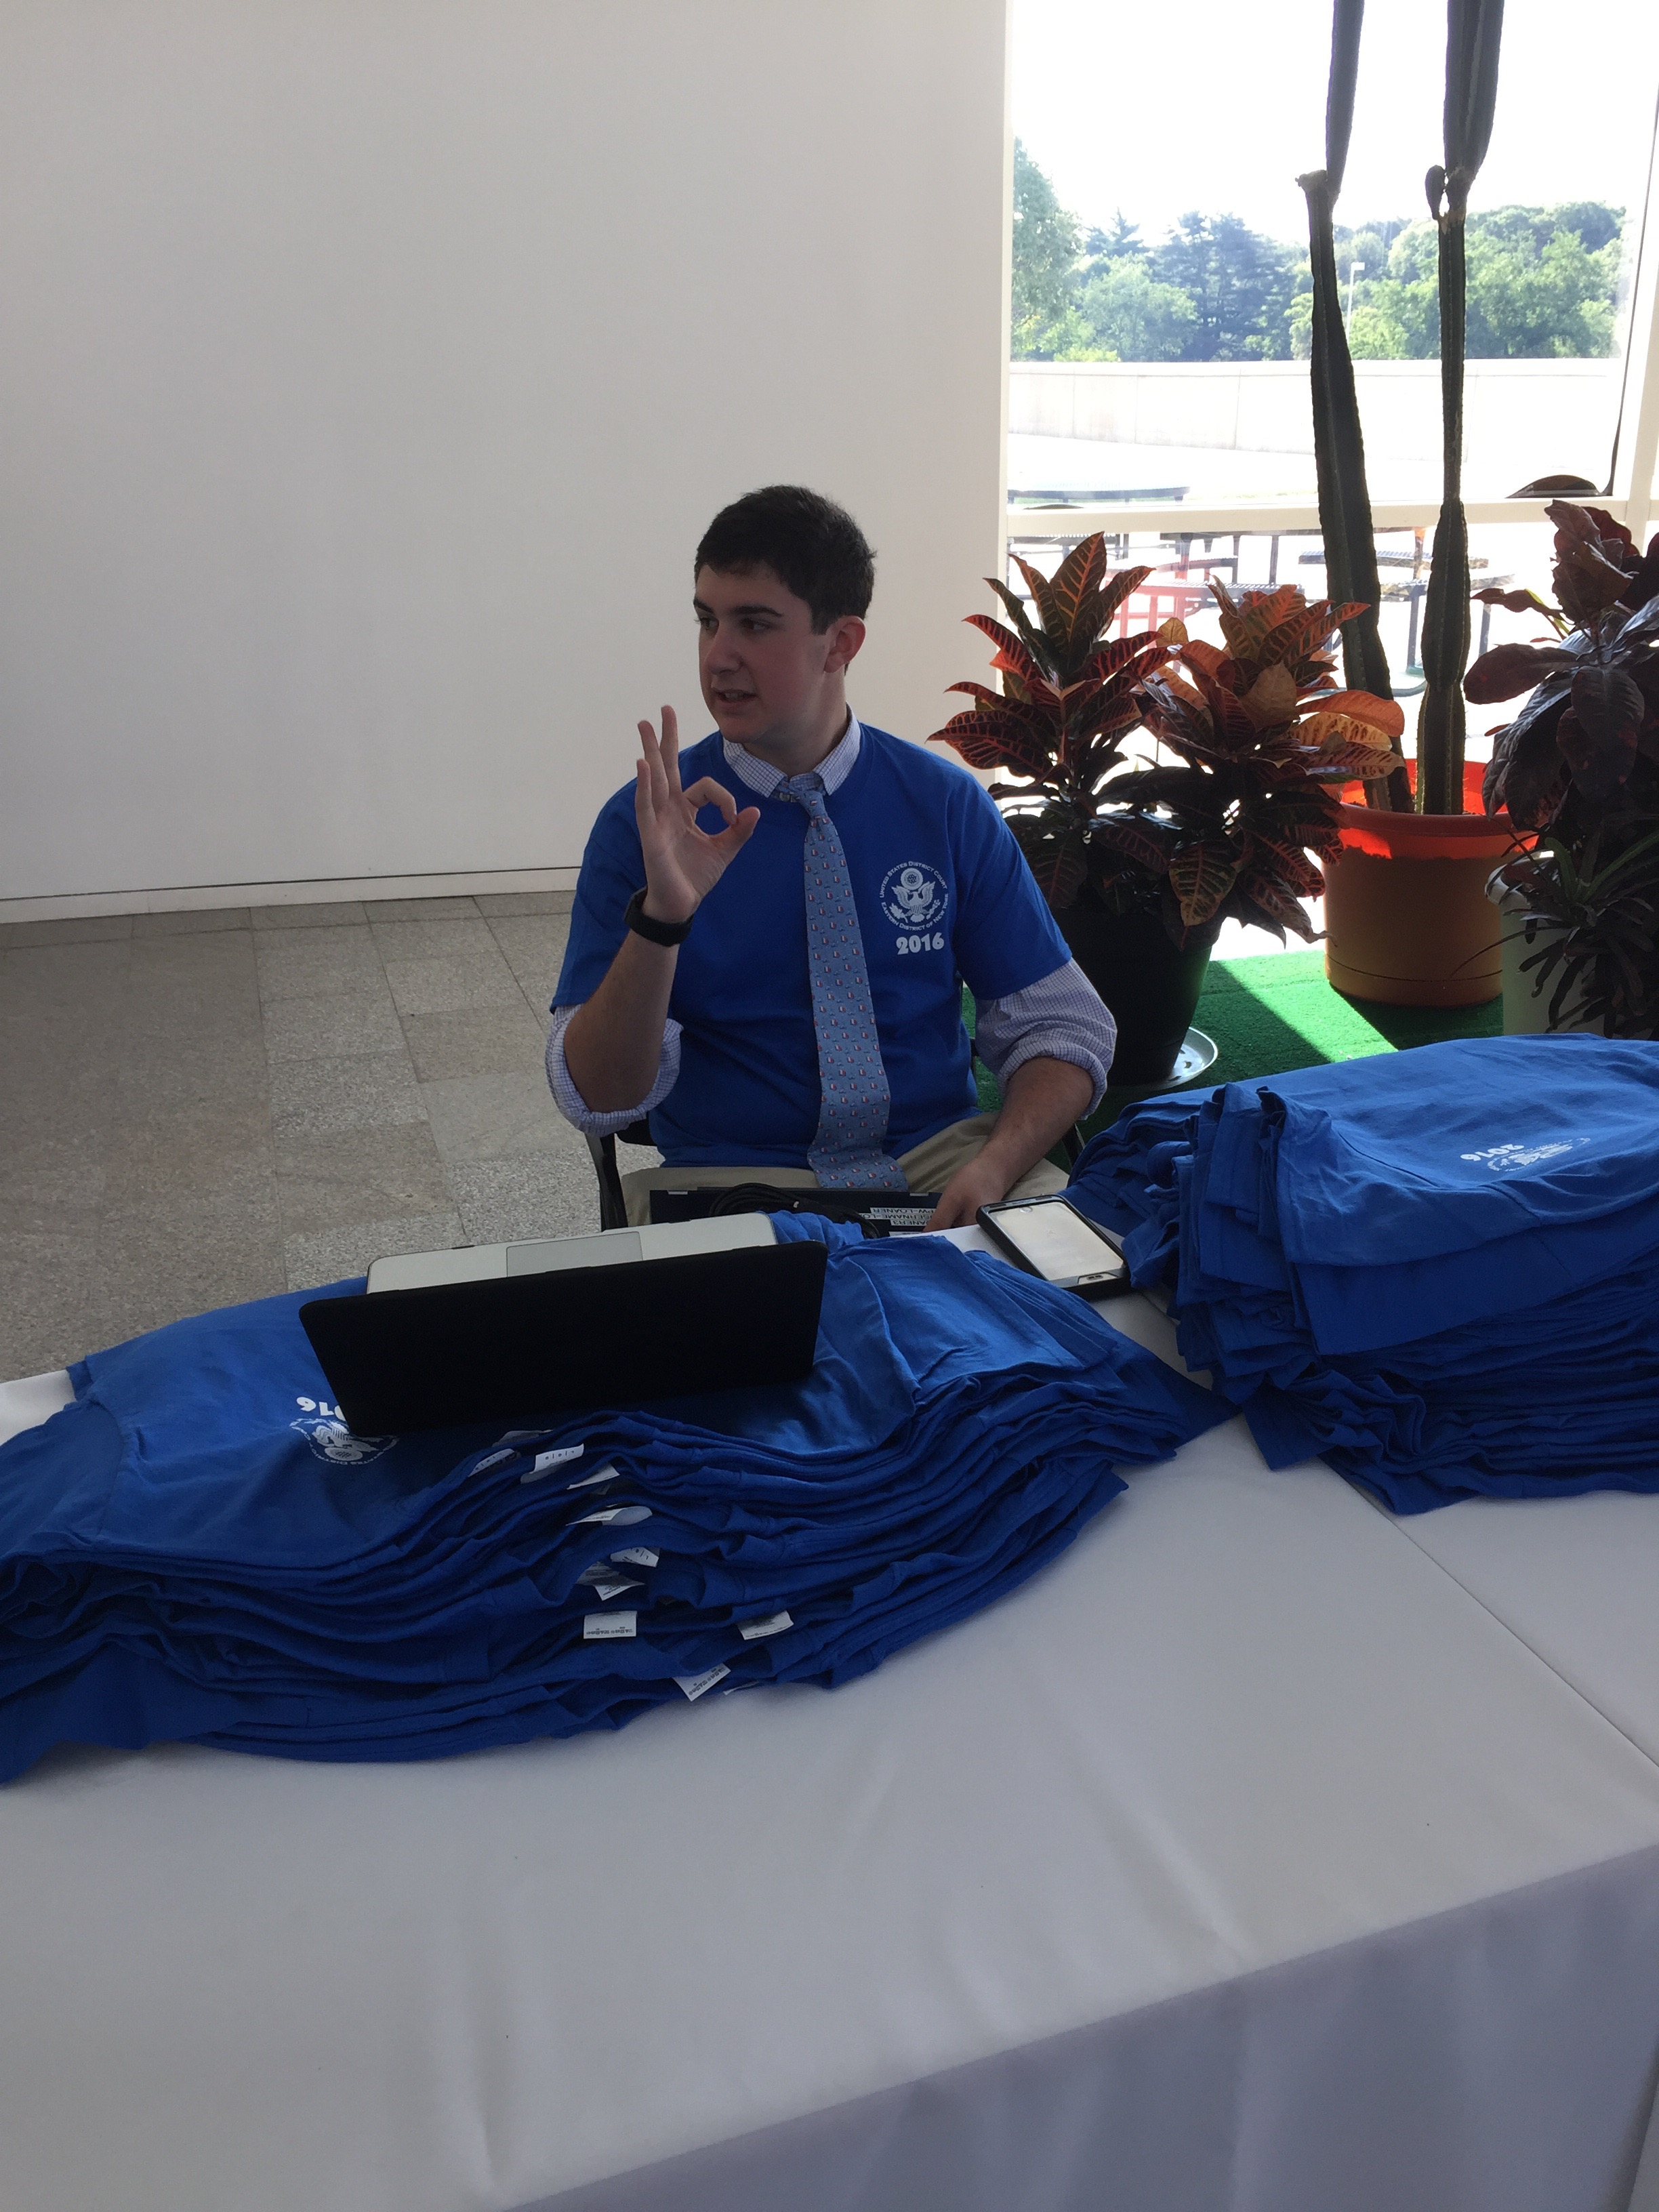
Purchase the Swag

Slide 17
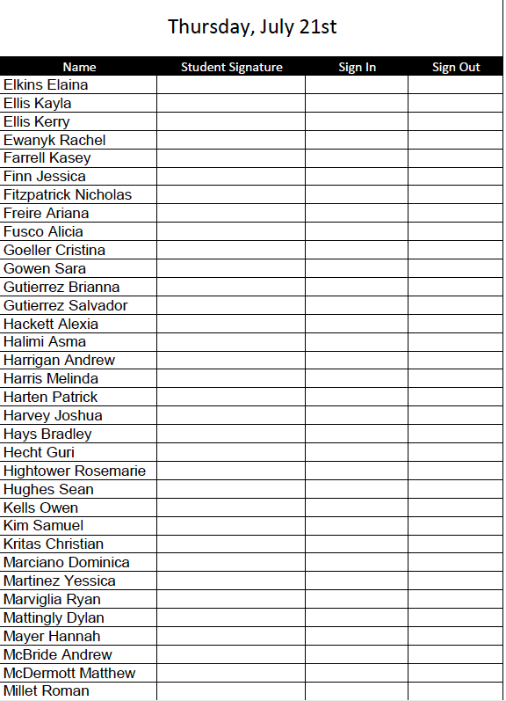
Keep Them Safe

Slide 18


Slide 19
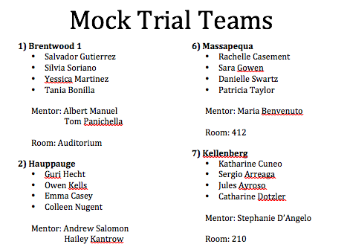
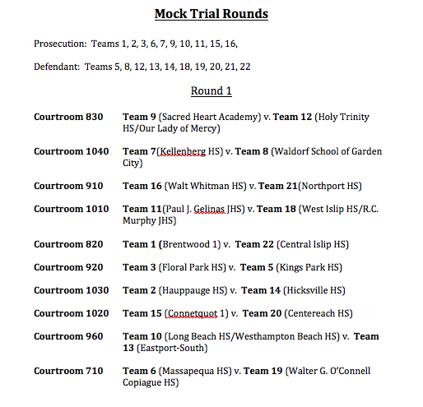
Get Ready to Compete

Slide 20
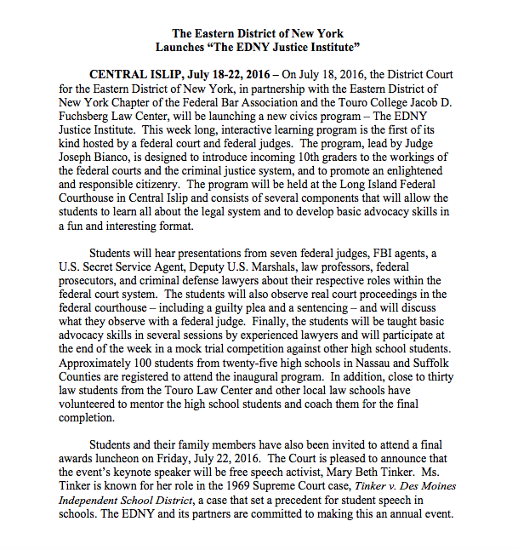
Don’t Forget to Advertise

Slide 21
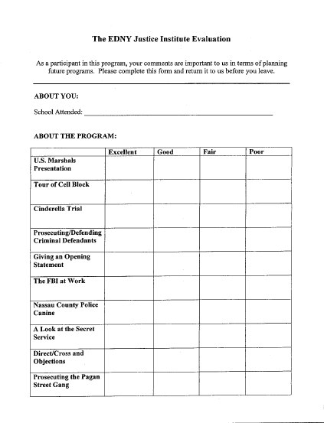
Ask for Feedback

Slide 22
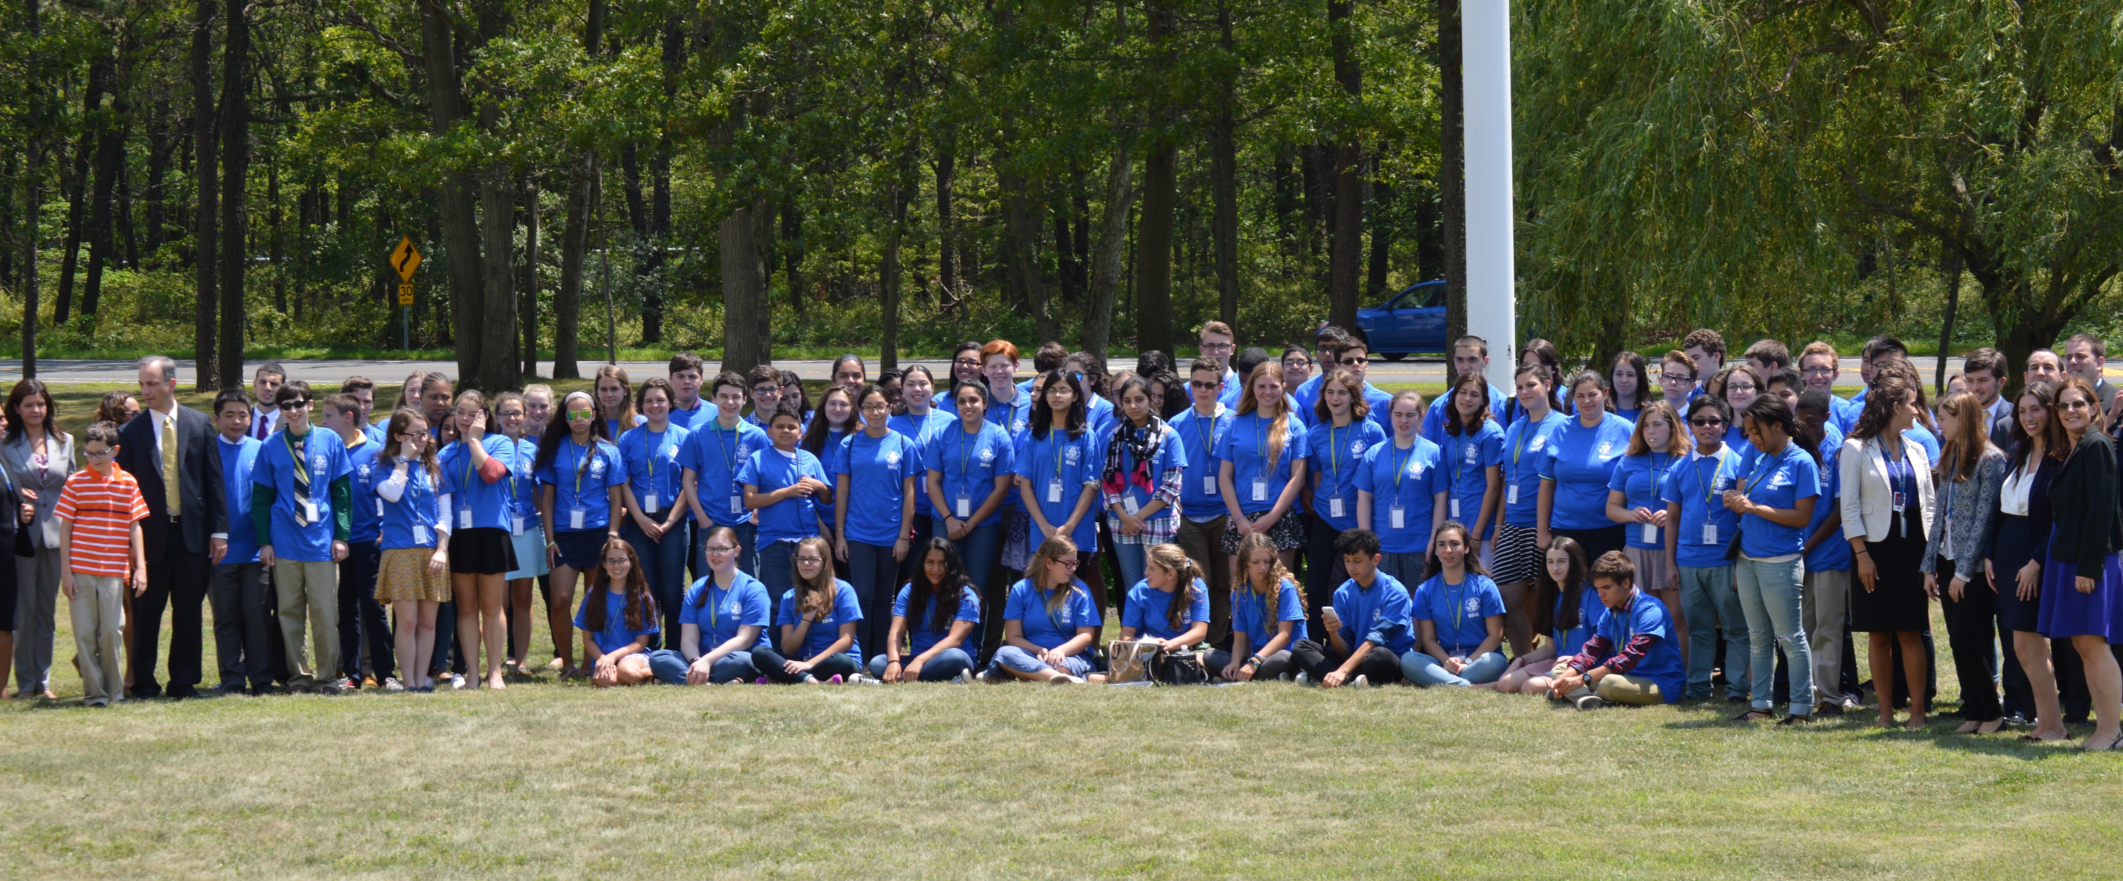
EDNY Justice Institute

