Slide 1

Maine Chapter

Slide 2
FBA Mission Statement
The mission of the Association is to strengthen the federal legal system and administration of justice by serving the interests and the needs of the federal practitioner, both public and private, the federal judiciary and the public they serve.

Slide 3
FBA National Membership
17,000+ Members and nearly 1,400 Law Student Members nationwide
Over 90 Chapters around the country
Retention rate of 82% (excluding law students and honorary members)
Benchmark: Retention rates for similar sized voluntary bar associations ranged from 82-97%

Slide 4
Monthly Membership Counts FY 2013-2015
17,264

Slide 5


Where are FBA Members?

Slide 6


FBA Member Demographics

Slide 7
FBA Sections and Divisions
Sections
Admiralty
Alternative Dispute Resolution
Antitrust & Trade Regulation
Banking
Bankruptcy
Civil Rights
Criminal
Environment, Energy, & Natural Resources
Federal Litigation
Government Contracts
Health
Immigration
Divisions
Corporate & Association Council
Federal Career Services
Judiciary
Senior Lawyers
Younger Lawyers
Law Student
Indian
Intellectual Property
International
Labor & Employment
Qui Tam
Securities Law
Social Security
State & Local Government Relations
Taxation
Transportation & Transportation Security Law
Veterans Law

Slide 8

FBA Sections and Divisions

Slide 9

FBA Sections and Divisions

Slide 10

FBA Social Media

Slide 11
Maine Chapter Membership
Sections and Divisions within the Maine Chapter that have the Most Members

Slide 12
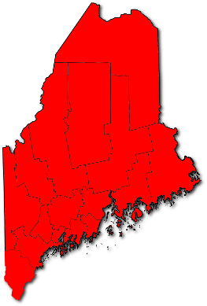
Maine Chapter Membership
27 Total Members

Slide 13

What’s New? – Member Plus Program
FBA members receive discounts from over 25 companies.
Participating organizations include: Avis, Budget, HP, Liberty Mutual, OfficeMax, UBER, UPS, and more.
For a full list of participating partners please visit fedbar.org.

Slide 14

What’s New? - Judicial Profile Index
Contains profiles published in The Federal Lawyer magazine
All profiles from 2007 to present
Organized by circuit and district
Search by keyword
Updated quarterly with both new profiles and historical profiles

Slide 15

What Next? – Coming Soon!

Slide 16

What Next? – Coming Soon!

Slide 17

Second Annual Women in the Law Conference
This year, Chapters, Sections and Divisions can send two registrants for the price of one!

