Slide 1

Lafayette/Acadiana Chapter

Slide 2
FBA Mission Statement
The mission of the Association is to strengthen the federal legal system and administration of justice by serving the interests and the needs of the federal practitioner, both public and private, the federal judiciary and the public they serve.

Slide 3
FBA National Membership
17,000+ Members and nearly 1,400 Law Student Members nationwide
Over 90 Chapters around the country
Retention rate of 82% (excluding law students and honorary members)
Benchmark: Retention rates for similar sized
voluntary bar associations ranged from 82-97%

Slide 4
Monthly Membership Counts FY 2013-2015
17,264

Slide 5


Where are FBA Members?

Slide 6


FBA Member Demographics

Slide 7
FBA Sections and Divisions
Sections
  Admiralty
  Alternative Dispute Resolution
  Antitrust & Trade Regulation
  Banking
  Bankruptcy
  Civil Rights
  Criminal
  Environment, Energy, & Natural Resources
  Federal Litigation
  Government Contracts
  Health
  Immigration
Divisions
  Corporate & Association Council
  Federal Career Services
  Judiciary
  Senior Lawyers
  Younger Lawyers
  Law Student
  Indian
  Intellectual Property
  International
  Labor & Employment
  Qui Tam
  Securities Law
  Social Security
  State & Local Government Relations
  Taxation
  Transportation & Transportation Security Law
  Veterans Law

Slide 8

FBA Sections and Divisions

Slide 9

FBA Sections and Divisions

Slide 10

FBA Social Media

Slide 11
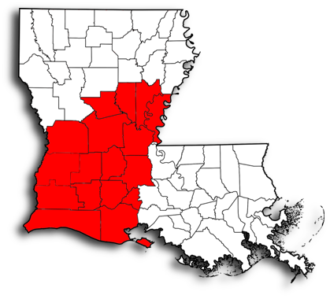
Lafayette/Acadiana Chapter Membership
131 Total Members

Slide 12
Lafayette/Acadiana Chapter Membership
Sections and Divisions within the Lafayette/Acadiana Chapter that have the Most Members

Slide 13

What’s New? – Member Plus Program
FBA members receive discounts from over 25 companies.
Participating organizations include: Avis, Budget, HP, Liberty Mutual, OfficeMax, UBER, UPS, and more.
For a full list of participating partners please visit fedbar.org.

Slide 14

What’s New? - Judicial Profile Index
Contains profiles published in The Federal Lawyer magazine
All profiles from 2007 to present
Organized by circuit and district
Search by keyword
Updated quarterly with both new profiles and historical profiles

Slide 15

What Next? – Coming Soon!

Slide 16

What Next? – Coming Soon!

