Slide 1
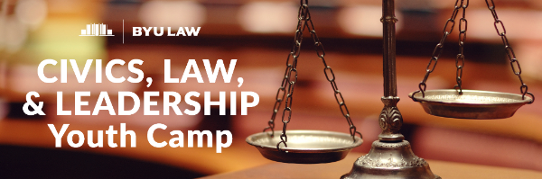
July 31-August 4, 2017

Slide 2
A camp seeking to build the next generation of civic-minded leaders!
A joint effort involving the FBA, Utah District Court, the Administrative Office of the Courts, and BYU Law School
A five day, overnight camp on the BYU campus in Provo, Utah, for high school students from around the country
Classes, interactive participation, moot court, and social activities
Cost: $575 per student, all inclusive except for travel

Slide 3
Combined efforts
University
  Registration, housing, meals, administrative support, social activities, supervision
Law School
  Camp directors, general oversight, classroom instruction by law professors, law student mentors (all will sign up with FBA law student division)
FBA
  Support at all levels, Utah chapter members will help present some topics and help host luncheon at courthouse, FBA Pres. Judge Newman will speak, application for financial support
Administrative Office of the U.S. Courts (AO)
  Assisted with developing curriculum and given permission for use of curriculum resources
U.S. District Court for District of Utah
  Host the camp for a full day, Judges will speak and mingle with students, scholarship support

Slide 4
AO Educational Resources
Rebecca Fanning, National Outreach Manager for the Federal Courts
http://www.uscourts.gov/about-federal-courts/educational-resources

Slide 5
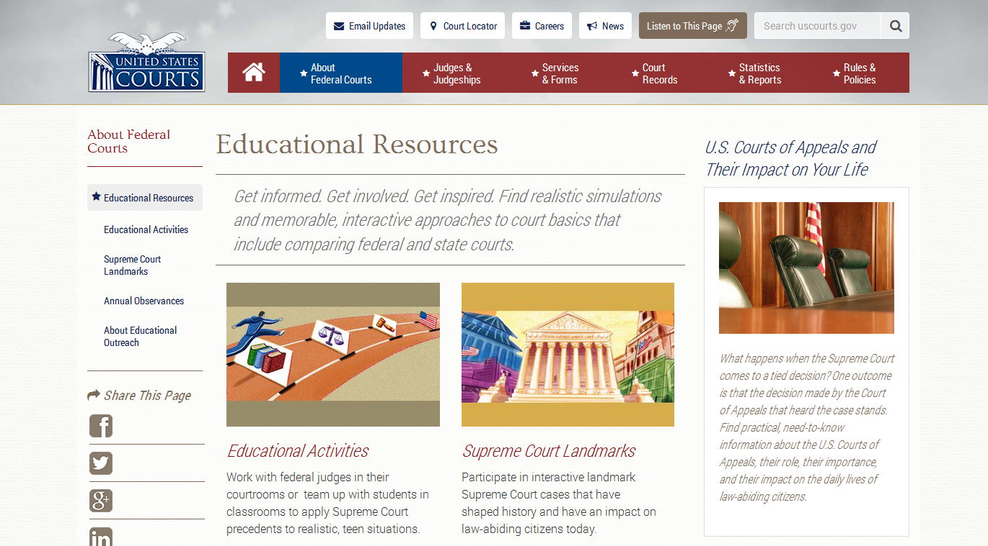

Slide 6
So far, applicants from 16 States:
AL
AZ
CA
CO
ID
KS
MD
MS
NC
NE
NM
OR
TX
UT
VA
WA

Slide 7
Wednesday: A Day at the Courthouse
Full day program
Meet and hear from Judges
Tour of courthouse hosted by Clerk of Court
Observe court proceedings
Interactive role play using simulation of Carey v. Musladin, based on materials from Administrative Office of the Courts.
Luncheon with attorneys from the Utah chapter of the FBA

Slide 8
Topics for Judges / Day at Court
Role of Courts
  Rule of Law / Equal Justice under Law
  Trial v. Appellate
  Civil v. Criminal
  Role of Judge as compared to Jury
  Jury Service
  Rules of Evidence and Rules of Procedure
  Presumption of Innocence and Burden of Proof
Basic concepts of the legal process
  How does one become a judge?
  Do juries always make the right decision?
  Are judges always fair?
  What makes a lawyer effective?
  Roles of others who are part of the court (clerks, marshal, security, etc.)

Slide 9
Subjects to be covered at the camp:
Founding History
  Declaration, Constitution, Bill of Rights, Amendments
Three Branches of Government and intro to Separation of Powers
Federalism / two court systems
Rule of law
Role of federal courts in protecting individual rights
Due Process and Equal Protection
Issues re Separation of Powers / Legislative Branch
Separation of Powers / Judicial Branch / Judicial Independence
Role of lawyers in a free society (including “To Kill a Mockingbird”)
Civility and citizenship
The legal system and legal careers
Moot Court (Free Speech / Tinker v. Des Moines)

Slide 10
Leadership Modules:
What is leadership?
Communication skills
Public speaking
Conducting meetings / creating agenda
Serving on a committee

Slide 11
Scholarships:
Goal of minimum of 15 students (at least 10% of total attendance) chosen from disadvantaged backgrounds
Cost: approximately $9,000.
Grant has been applied for from Foundation of the FBA.
District Court (via Bench and Bar fund) has committed to match or exceed scholarship funding from the FBA

Slide 12
Unconditional commitment to share
“Overnight” template could be replicated at any college or university that has the capacity to sponsor youth summer camps
A “day camp” variation could be replicated at any law school
Shorter but similar curriculum (2-3 days) could be implemented by way of a joint effort with an energetic chapter and a cooperative district court
Observers are welcome at BYU with modest advance notice

Slide 13
Unconditional commitment to share
BEST OF ALL:
All curriculum materials of the AO are freely shared
All materials and outlines from BYU Camp will be freely shared
BYU’s Continuing Education group will freely share economic concepts and administrative suggestions

Slide 14
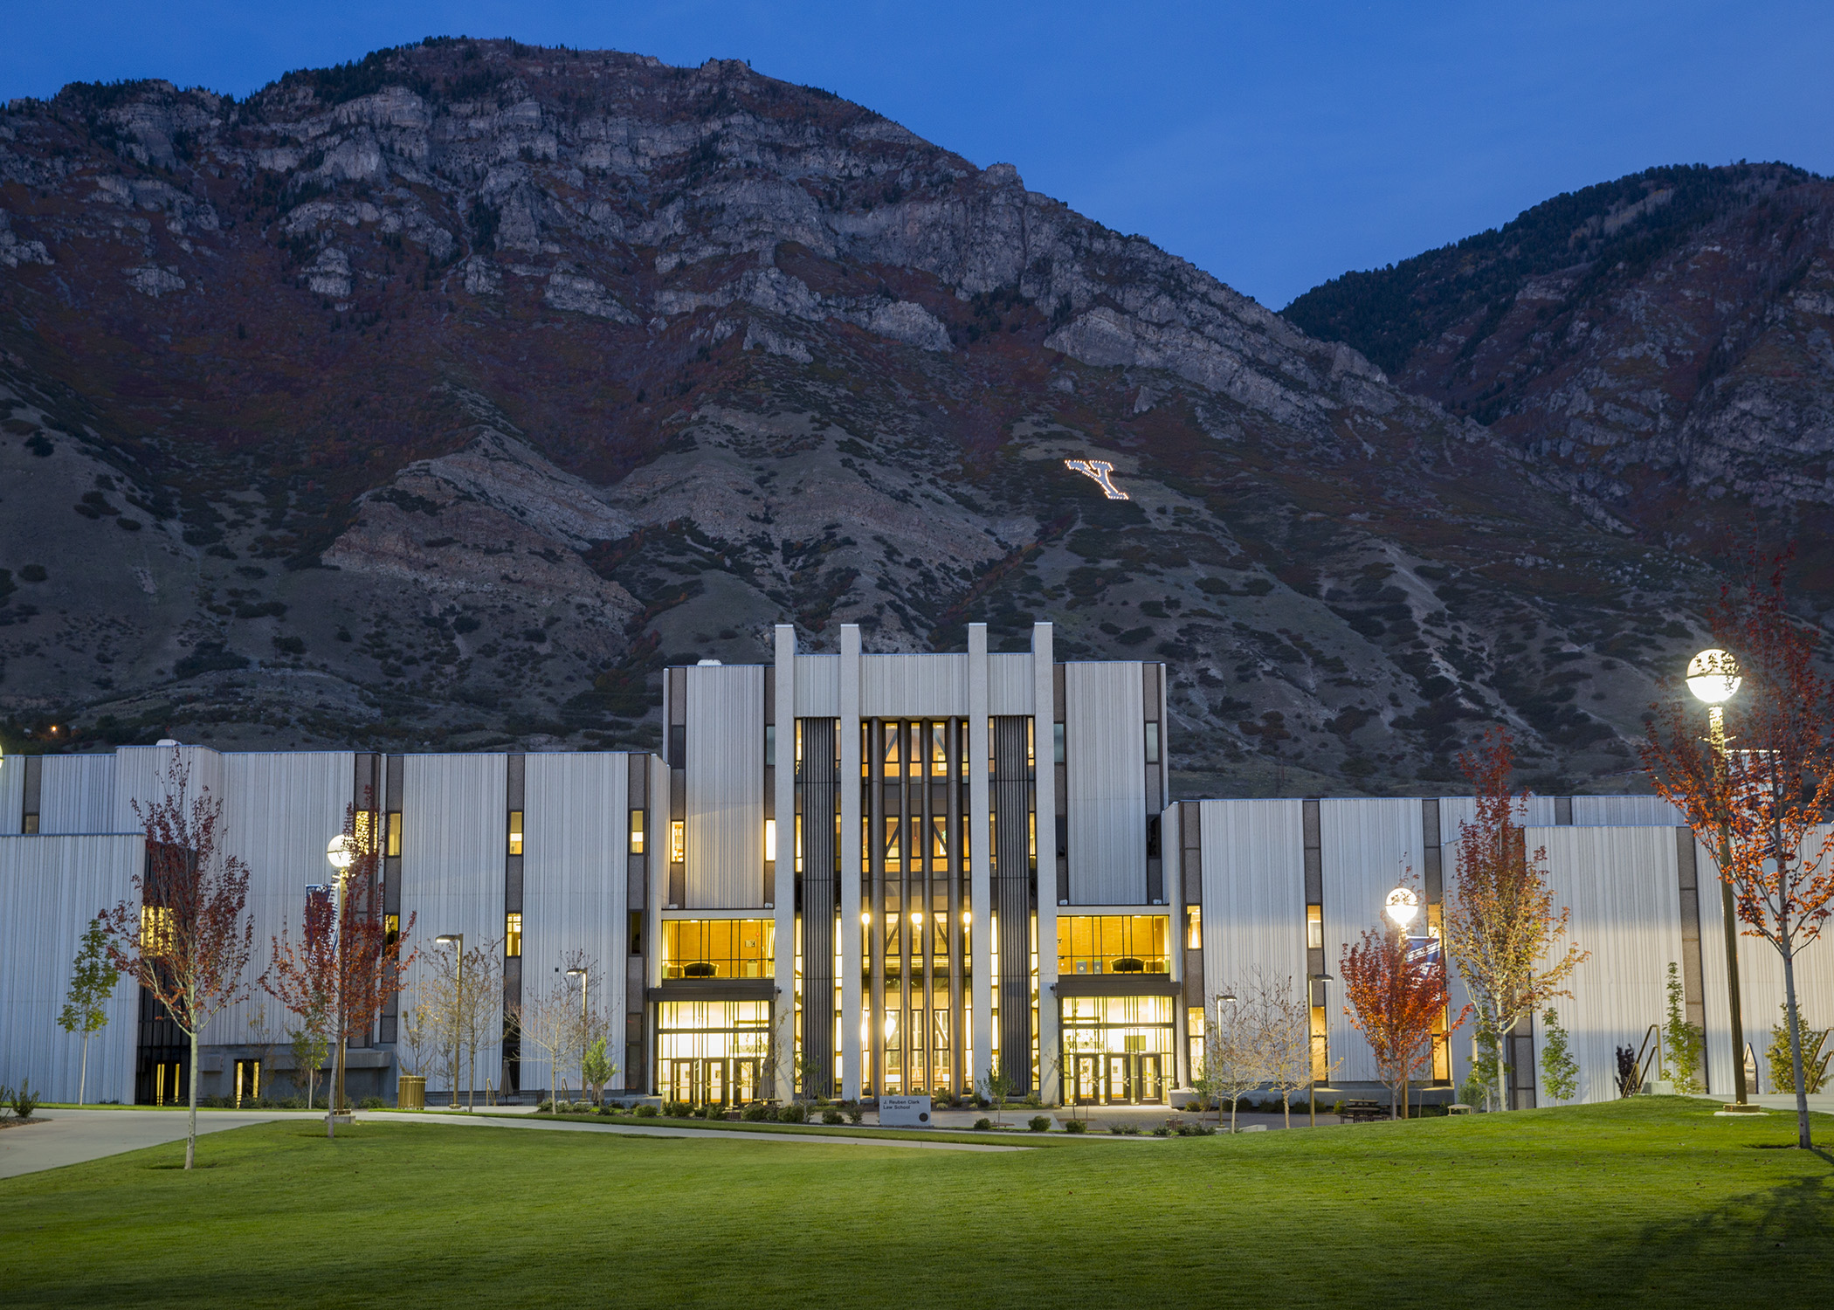
http://civicsleadership.ce.byu.edu/

