Slide 1
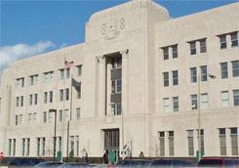
Fed Tide
Spring 2020
The Newsletter of the Hampton Roads Chapter of the Federal Bar Association
President
Suzanne Katchmar
Office of the Federal Public Defender
Vice President
Clark J. Belote
Kaufman & Canoles
Treasurer
Emily Munn
Bischofff Martingayle
Secretary
Dustin Paul
Vandeventer Black
Member at Large
Adam Carroll, Wolcott Rivers, Gates, P.C.
National Delegate
Stephen R. Jackson
Stephen R. Jackson, P.C.
Courthouse Liaison
Mark Warmbier United States District Court
Greetings FBA members and friends,
As we move into the holiday season, especially Thanksgiving, although 2020 has been an extremely challenging year, we have much to be thankful for and a strong sense of hope. This year the Hampton Roads Chapter has not only adapted, but excelled, at the constant change that has come our way. Moreover, it has been met with a collegiality and manner that truly shows the spirit of what it is to be a federal practitioner in the EDVA.
While our FBA chapter has not physically come together in quite some time, the Board has been looking for ways to bring us together, albeit virtually. On November 10, 2020, we will finally gather for our Annual Meeting by Zoom. Thanks to you, the response has been outstanding. We look forward to hearing from Chief Judge Davis as he shares how the courthouse family has adjusted to accommodate public heatlh concerns and what we hope will be an increased normalcy moving into 2021. Judge Novak will join us and share his experiences and lessons learned from presiding over a jury trial in the COVID-era, facing the risks and realities of a pandemic. As for the business at hand, the Board will ask your permission to continue “as is” while we continue to work through more creative ways to promote our mission.
As a current example, we are exploring collaborative events with different state, local and specialty bar associations, the first of which is the Intellectual Property program - previously scheduled for March 2020. As new associates begin with our members and their firms, we hope to continue our tradition of an admission ceremony in a safe, informative way that will still promote an inviting and communal atmosphere. We welcome all ideas in this new normal and look forward to hearing from you at HRFedBar@gmail.com.
Although we will greatly miss our annual luncheon at the Town Point Club for 2020, along with our informal quarterly luncheons at Kaufman & Canoles, we look to the not so distant future when we may enjoy those gatherings again
- Suzanne Katchmar, President

Slide 2
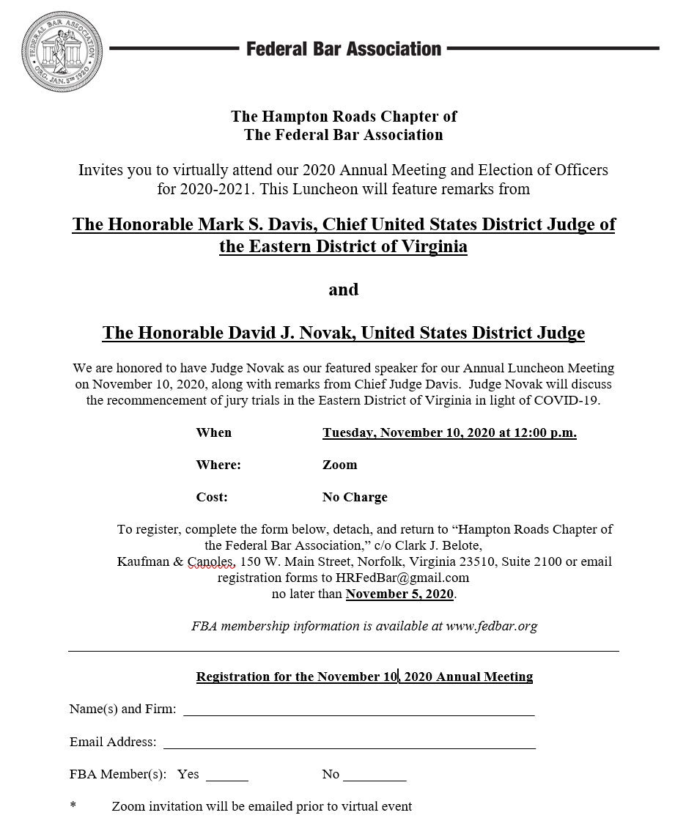
2020 Annual Meeting

Slide 3
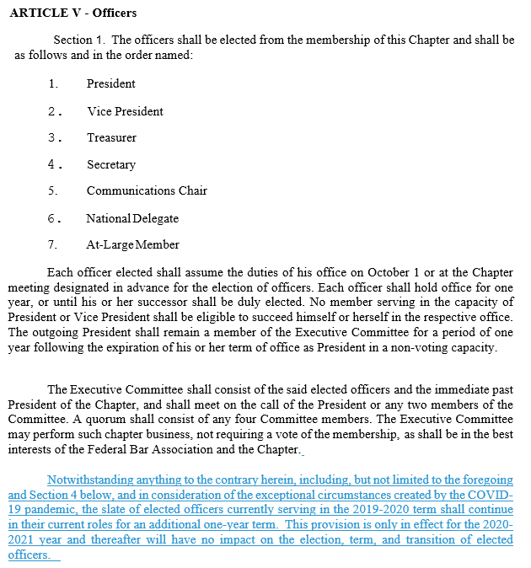
Proposed One-Time Bylaw Amendment
Please find below in redline the proposed amendment to Article V of the Chapter’s bylaws for 2020-21 only. Because COVID-19 effectively precluded in-person meetings for over 7 months, and in-person meetings are a key component of the function of our Chapter, Board members were limited in their ability to serve. The Board believes that allowing a one-time reelection of incumbents allows the Chapter to have the Board members carry out their service without changing the Bylaws’ election format long term.

Slide 4
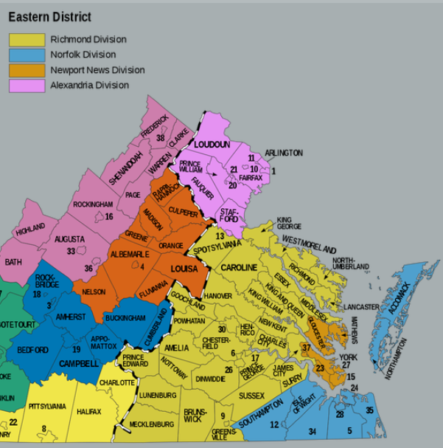
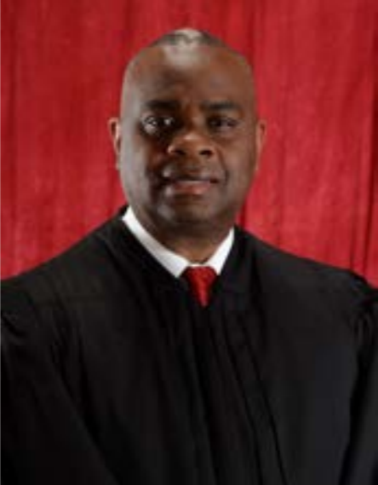
Hon. Roderick C. Young Confirmed by Senate
On September 24, 2020, the United States Senate confirmed the Honorable Roderick C. Young to fill the United States District Court Judgeship left vacant by Judge Rebecca Beach Smith’s assumption of senior status on August 1, 2019 after more than 30 years of dedicated service. Judge Young was confirmed by a 93-2 vote. President Trump nominated Judge Young on May 6, 2020.
Judge Young worked in the Public Defender’s office in Portsmouth before joining the Richmond Commonwealth’s Attorney’s office. He then served 12 years as an Assistant United States Attorney in Richmond. Judge Young formerly served as a United States Magistrate Judge in Richmond since 2014.
Judge Young is a native of Petersburg, Virginia. He received a B.A. from George Mason University and his J.D. from West Virginia University College of Law.

Slide 5
The Current Normal – COVID Protocols
Since March 10, 2020, Chief Judge Davis has entered over twenty (20) General Order concerning the impact of COVID-19 on the Court’s operation and procedures for the Eastern District of Virginia.
All of these order and the Court’s guidance can be found on the Court’s website here: https://www.vaed.uscourts.gov/covid-19.
While there are no longer any tolled deadlines, remember all persons entering the Courthouses (including attorneys) shall be required to:
wear a face covering that covers your nose and mouth.
Inside of each courtroom, the presiding judge may permit removal of face coverings for the purposes of facilitating a hearing
(2) engage in social distancing within the Courthouses whenever possible; and
(3) stay home if you are sick.
The Court has also issued multiple general orders providing for remote hearings by video and teleconferencing for civil and criminal hearings, including the use of Zoomgov, when consent is provided in accordance with applicable statutes and rules of the Judicial Conference of the United States. This includes felony pleas under Rule 11 of the Federal Rules of Criminal Procedure and felony sentencings under Rule 32 of the Federal Rules of Criminal Procedure. Zoom hearings can be useful for alternative for in-person court appearances. Please stay safe.

Slide 6
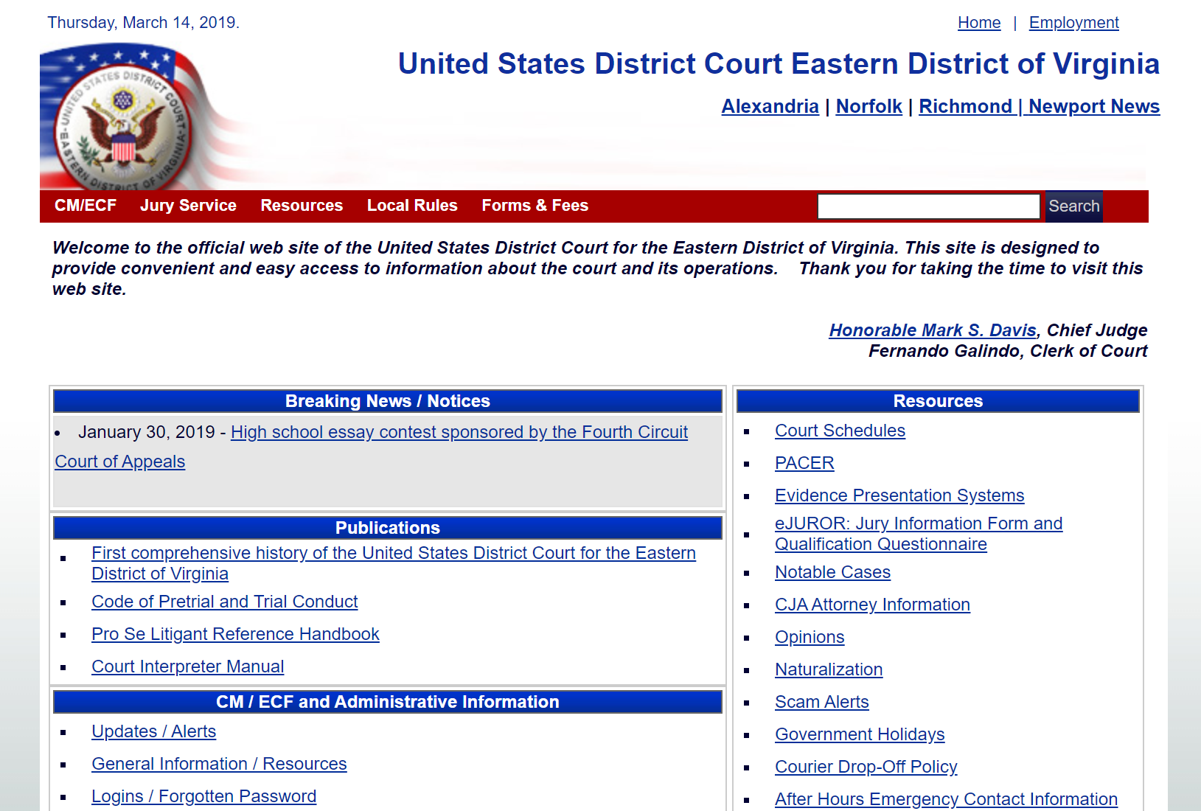
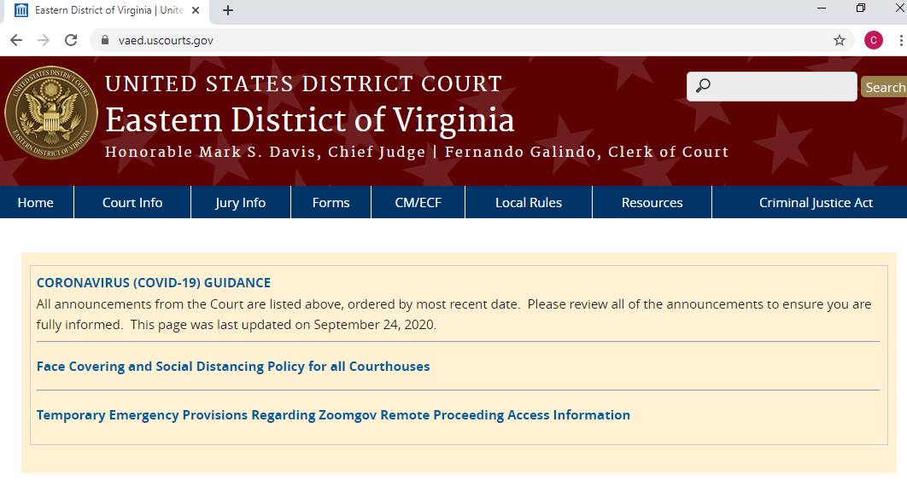
NEW LOOK for the EDVA Website
The website for the United States District Court for the Eastern District of Virginia has a new look (below). Don’t forget you can find Judge and Division-specific information (including courtesy copy requirements) right here: https://www.vaed.uscourts.gov/sites/vaed/files/Division%20Specific%20Copies%20NorNN_101420.pdf

Slide 7
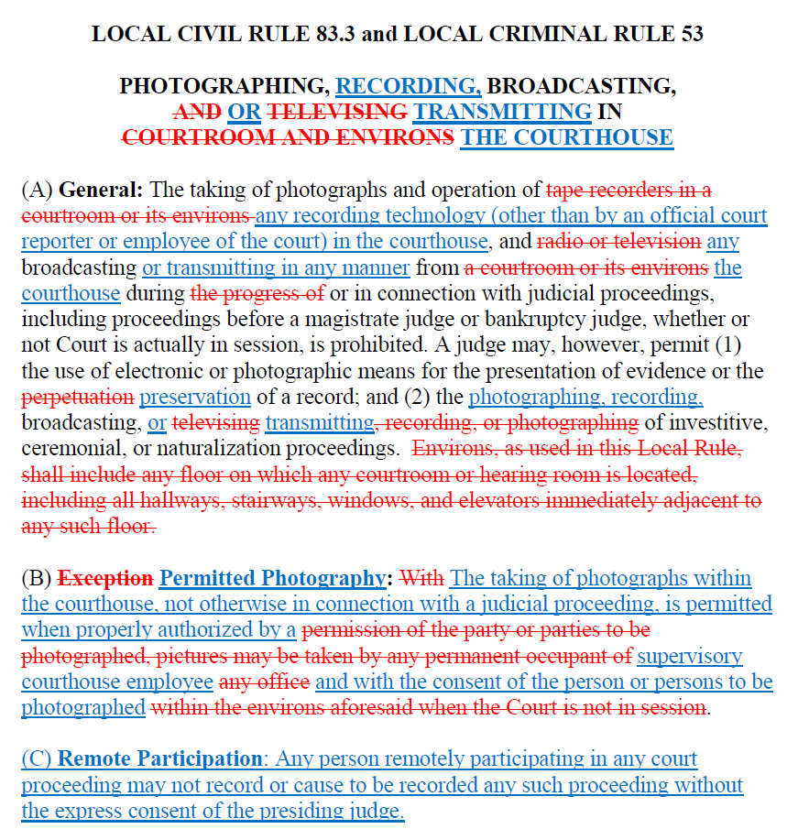
Proposed Local Rule Changes
The Court has announced proposed changes to the Local Rules. These changes concern Local Civil Rule 83.3 and Local Criminal Rule 53 on recording of court proceedings. Please find below redlined versions of the proposed amendments with a justification for each change, and a clean post-amendment version of each rule. Comments on the proposed amendments must be submitted by U.S. mail or email before November 16, 2020 to:
Fernando Galindo
Clerk of Court
U.S. District Court for the Eastern District of Virginia
600 Granby Street
Norfolk, VA 23510
localrulecomment@vaed.uscourts.gov

Slide 8
Proposed Federal Rule Changes
On June 23, 2020, the Judicial Conference Committee on Rules of Practice and Procedure (Standing Committee) approved publication of proposed amendments to the following:
Appellate Rule 25;
Bankruptcy Restyled Rules Parts I and II; Rules 1007, 1020, 2009, 2012, 2015, 3002, 3010, 3011, 3014, 3016, 3017.1, 3017.2 (new), 3018, 3019, 5005, 7004, and 8023; and Official Forms 101, 122B, 201, 309E-1, 309E-2, 309F-1, 309F-2, 314, 315, and 425A;
Civil Rule 12 and Supplemental Rules for Social Security Review Actions Under 42 U.S.C. § 405(g); and
Criminal Rule 16
The full slate of changes is available here: https://www.uscourts.gov/sites/default/files/preliminary_draft_of_proposed_amendments_to_federal_rules_august_2020_0.pdf
Of note are:
Civil Rule 12: A proposed amendment to Civil Rule 12(a)(4) provides a United States officer or employee sued in an individual capacity for an act or omission occurring in connection with duties performed on the United States’ behalf with 60 days to serve a responsive pleading after the court denies a motion under Rule 12 or postpones its disposition until trial. The United States often represents the officer or employee in such actions. The same reasons that support the 60-day time to answer in Rule 12(a)(3) apply when the answer is required after denial or deferral of a Rule 12 motion.
Criminal Rule 16: The proposed amendment addresses two shortcomings of the current provisions on expert witness disclosure: (1) the lack of an enforceable deadline for disclosure; and (2) the lack of adequate specificity regarding what information must be disclosed. The amendment clarifies the timing and content of expert witness disclosures. It is intended to facilitate trial preparation by allowing the parties a fair opportunity to prepare to cross-examine expert witnesses who testify at trial and to secure opposing expert testimony if needed.

Slide 9
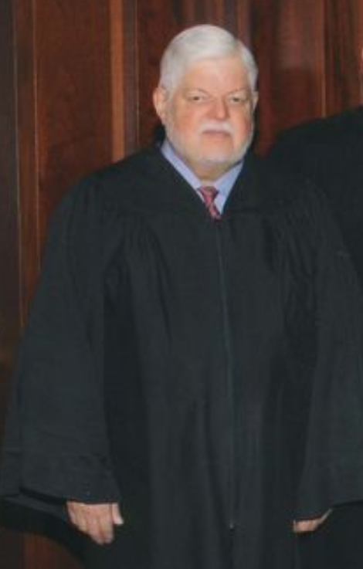
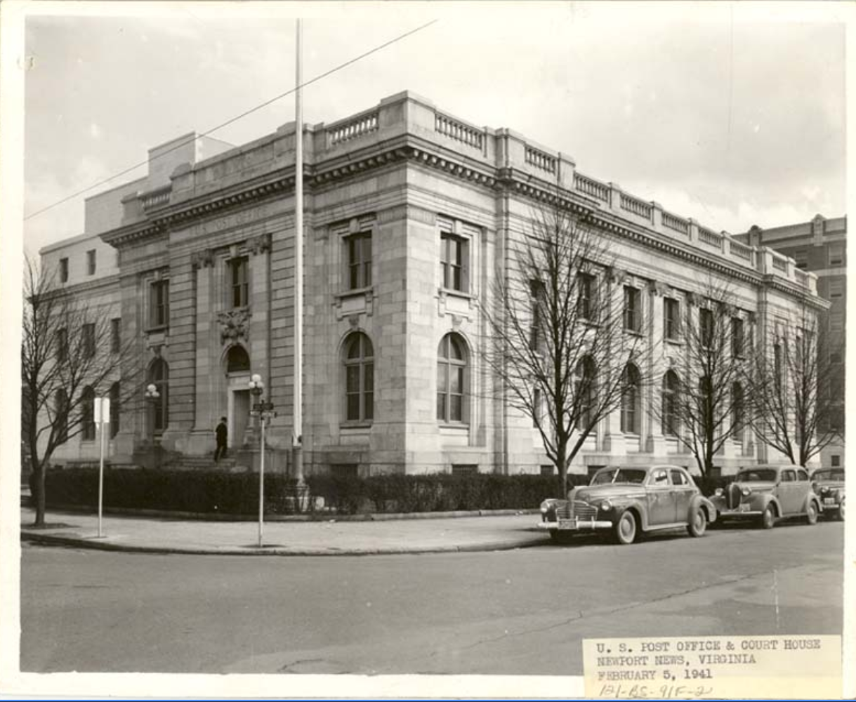
In Memoriam – Hon. James E. “Jim” Bradberry
On July 25, 2020, retired United States Magistrate Judge James E. “Jim” Bradberry, 80 passed away at his home of heart failure. Judge Bradberry was the last federal judge based primarily in Newport News. His chambers were in the historic federal courthouse on the second floor of the 1940s-era Post Office on 26th Street until it closed in 2002. Judge Bradberry received his undergraduate degree from the University of Wisconsin and his law degree from the University of Virginia. He served in the Army’s Judge Advocate General Corps, then spent a year as a Newport News prosecutor, before working in private practice in Newport News from 1971 to 1991. He was on the bench from the early 90’s until his retirement in 2009. Judge Bradberry had many notable cases over the years, including dismissing a defamation lawsuit against Sports Illustrated for a story about the Allen Iverson bowling alley brawl in 1994. Judge Bradberry will be missed by his colleagues, former law clerks, and practicing attorneys.

Slide 10
New Magistrate Judge in Richmond
Hon. Elizabeth W. Hanes was sworn in on June 12, 2020 as the newest United States Magistrate Judge for the Eastern District of Virginia. She will sit in the Richmond Division. Judge Hanes is a former law clerk for the Honorable Robert B. King, United States Court of Appeals for the Fourth Circuit and the Honorable Joseph R. Goodwin, United States District Court for the Southern District of West Virginia. She served as an Assistant Federal Public Defender from 2009 until 2016 and then worked in private practice on civil matters with the law firm Consumer Litigation Associates, P.C. She is a graduate of the University of Richmond School of Law in Richmond, Virginia.
6-Week Zoom Trial Results in Massive Verdict
Senior United States District Judge Henry Coke Morgan, Jr. issued findings of facts and conclusions of law on October 5, 2020 in the case of Centripetal Networks Inc. (of Herndon, Virginia) v. Cisco Systems. Judge Morgan’s verdict is historic for two notable reasons. First, it was one of the first trials conducted entirely by Zoom (over the course of a month). Exhibit binders were delivered to chambers while witnesses and counsel appeared remotely. Second, it is believed to be one of the largest verdicts in the history of the Eastern District of Virginia and one of the largest known patent verdicts. Judge Morgan ordered Cisco to pay $1.89 billion in damages, plus prejudgment interest. Judge Morgan found that Cisco willfully infringed four of Centripetal’s patents. The patents at issue concern technology that can detect malware encrypted data packets flowing through networks—an increasingly common technique from cybercriminals trying to sneak through malicious code. Cisco has indicated that it will appeal to the United States Court of Appeals for the Federal Circuit. The case is Civil Action No. 2:18cv94.

Slide 11
News and Notes:
As a result of the pandemic, the case management team quickly adjusted to the need for increased telework, and implemented many electronic procedures to accommodate this new reality. For example, the team created a streamlined electronic system for processing search warrants and pen registers, which has saved significant time and resources. Additionally, the CM/ECF garnishment procedures have been modified, and attorneys are now permitted to e-file the appropriate paperwork.
In August 2019, a Superseding Indictment was returned that went from a 7-defendant, 6-count criminal conspiracy to a 41-defendant, 106-count criminal conspiracy. This case was one of the largest conspiracy cases ever filed in the Norfolk/Newport News Divisions. The case has since grown to a total of 45 defendants. The mere act of entering the indictment into CM/ECF involved preparation and planning over the course of several days. The case remains active with defendants petitioning the court to reduce their sentences, requesting docket sheets, and filing motions for compassionate release.
The case load managed by the Clerk’s Office has increased due to the influx of motions for compassionate release. The case management team has created internal procedures to effectively manage these additional filings.
The court’s website, which has been under construction for many months, was recently finalized and is now active.
The Norfolk/Newport News CJA Panel Committee was created, and has met on several occasions. The new committee has been very busy reviewing the application process. Over the course of several months, a new CJA Application was created, and new procedures were implemented to ensure the support of the existing panel, and to give new attorneys an opportunity to learn via a mentor program.
The Magistrate Courtroom Deputies have done an outstanding job in transitioning to remote hearings for initial appearances, detention hearings, and other matters.
Judge Morgan recently conducted a patent infringement trial via ZoomGov.
The District recently selected Brian Peters for a new “team leader” position
- Angela Farlow

Slide 15
Hampton Roads Chapter Membership
We ask our current members to encourage their colleagues or associates to join the FBA. Please contact a board member with any membership questions!
Fed Tide is a publication of the Hampton Roads Chapter of the Federal Bar Association. Any opinions or views published in Fed Tide do not necessarily imply approval by the FBA, the Hampton Roads Chapter or any agency or firm with which the editors or authors are associated. All copyrights are held by the Hampton Roads Chapter of the FBA unless otherwise noted by the author.
Members of the Hampton Roads Chapter are encouraged to submit articles or news information of interest for possible publication in the Fed Tide. Please submit any proposed articles or news information to the Editors at the e-mail addresses listed below. The Editors reserve the right to decide on publication, and any articles accepted for publication are subject to editing.
Contact Us:
HRFedBar@gmail.com
LOOKING AHEAD
November 10, 2020 – Annual Luncheon (Virtual)
Judge Young Investiture
(date forthcoming)
Need CLE credit before the deadline? Check out FBA’s free webinars here: https://www.fedbar.org/continuing-legal-education/webinars-2/

